Slide 1
Microsoft Project
Setting Up Resources
Adapted from the Microsoft Step by Step Series by Aaron Schroeder

Slide 2
Setting Up Resources
In this section, you will go over how to
Set up basic resource information for the people who work on projects
Enter basic resource information for the equipment that will be used in projects
Enter resource information for the materials that will be consumed as the project progresses
Enter cost resource information for financial tracking
Set up cost information for work resources
Change a resource’s availability for work
Record additional information about a resource in a note

Slide 3
What’s a resource?
Resources include the people and equipment needed to complete the tasks in a project
Microsoft Office Project 2007 focuses on two aspects of resources
  Availability
    when specific resources can work on tasks and how much work they can perform
  Costs
    how much money will be required to pay for those resources
In addition, Project will track materials and their associated costs

Slide 4
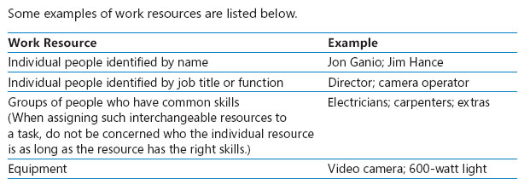
What’s a resource?

Slide 5
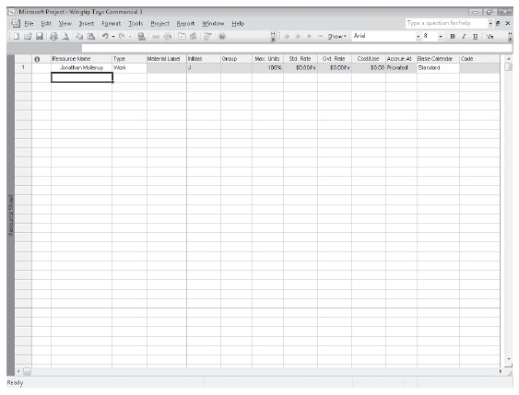
Setting Up People Resources
Open Wingtip Toys 3a
On the View menu, click Resource Sheet
  You will use the Resource Sheet view to help set up the initial list of resources for the Wingtip Toys TV commercial project
In the Resource Sheet view, click the cell directly below the Resource Name column heading
Type Jonathan Mollerup, and press Enter
Project creates a new resource.

Slide 6
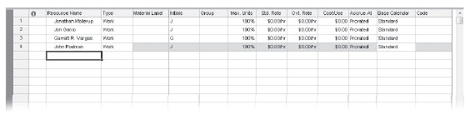
Setting Up People Resources
On the next empty rows in the Resource Name column, enter the following names
  Jon Ganio
  Garrett R. Vargas
  John Rodman

Slide 7
Setting Up People Resources
You can also have a resource that represents multiple people
  In the Resource Name field below the last resource, type Electrician, and then press
  Tab
  In the Type field, make sure that Work is selected and then press Tab several times to move to the Max Units field

Slide 8
Setting Up People Resources
The Max. Units field represents the maximum capacity of a resource to accomplish any task
Specifying that a resource, such as Jon Ganio, has 100% maximum units means that 100% of Jon’s time is available to work on the tasks to which you assign him
Project will alert you if you assign Jon to more tasks than he can accomplish at 100% maximum units (in other words, if Jon becomes overallocated)
As you can see, 100% is the default Max. Units value for new resources

Slide 9
Setting Up People Resources
In the Max. Units field for the electrician, type or select 200%, and then press Enter
The resource named Electrician does not represent a single person; instead, it represents a category of interchangeable people called electricians
Because the Electrician resource has a Max. Units setting of 200%, you can plan on two electricians being available to work full time every workday
At this point in the planning phase, it is alright that you do not know exactly who these electricians will be
You can still proceed with more general planning

Slide 10
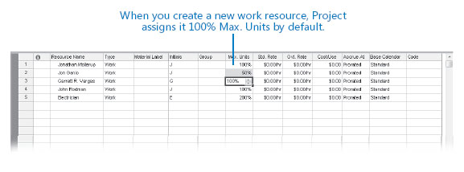
Setting Up People Resources
Now you’ll update the Max. Units value for Jon Ganio to indicate that he works half time
Click the Max. Units field for Jon Ganio, type or select 50%, and then press Enter

Slide 11
Setting Up Equipment Resources
In Project, you set up people and equipment resources in exactly the same way because people and equipment are both examples of work resources
However, you should be aware of important differences in how you can schedule these two work resources
  Most people resources have a working day of no more than 12 hours, but equipment resources might work around the clock
  People resources might be flexible in the tasks they can perform, but equipment resources tend to be more specialized
    For example, a director of photography for a film or video project might also act as a camera operator in a pinch but a video camera cannot replace an editing studio

Slide 12
Setting Up Equipment Resources
You do not need to track every piece of equipment that will be used in your project but you might want to set up equipment resources when
  Multiple teams or people might need a piece of equipment to accomplish different tasks simultaneously, and the equipment might be overbooked
  You want to plan and track costs associated with the equipment

Slide 13
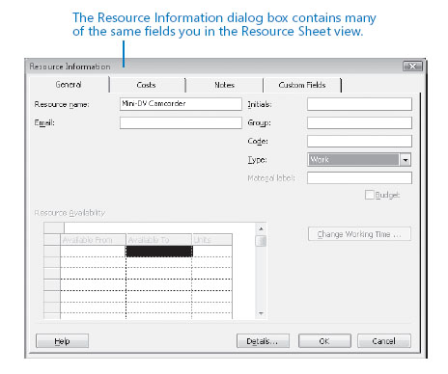
Setting Up Equipment Resources
In the Resource Sheet, click the next empty cell in the Resource Name column
On the Standard toolbar, click the Resource Information button (next to the Notes button)
The Resource Information dialog box appears
You can also double-click a resource name or an empty cell in the Resource Name column to display the Resource Information dialog box

Slide 14
Setting Up Equipment Resources
Click the General tab if it is not already displayed
In the Resource name field, type Mini-DV Camcorder
In the Type field, click Work
Click OK to close the Resource Information dialog box and return to the Resource Sheet

Slide 15
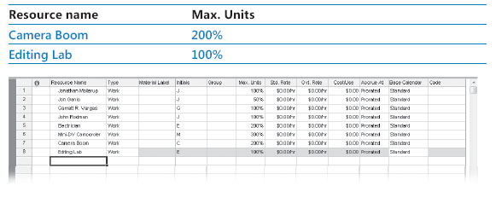
Setting Up Equipment Resources
The Max. Units field shows 100% for this resource
In the Max. Units field for the Mini-DV Camcorder, type or click the arrows until the value shown is 300% and press Enter
This means that you plan to have three camcorders available every workday
Enter the following information about equipment resources directly in the Resource Sheet or in the Resource Information dialog box, whichever you prefer

Slide 16
Setting Up Material Resources
Material resources are consumables that you use up as the project proceeds
On a construction project, material resources might include nails, lumber, and concrete
Forthe toy commercial project, video tape is the consumable resource that interests you most
You work with material resources in Project mainly to track the rate of consumption and the associated cost
Although Project is not a complete system for tracking inventory, it can help you stay better informed about how quickly you are consuming your material resources

Slide 17
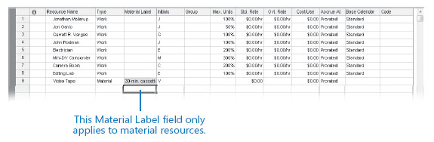
Setting Up Material Resources
In the Resource Sheet, click the next empty cell in the Resource Name column
Type Video Tape and press Tab
In the Type field, click the down arrow, select Material, and press Enter
In the Material Label field, type 30-min. cassette and press Enter

Slide 18
Setting Up Material Resources
You will use 30-minute cassettes as the unit of measure to track video tape consumption during the project
Note that you cannot enter a Max. Units value for a material resource
Since a material resource is a consumable item and not a person or piece of equipment that performs work, the Max. Units value doesn’t apply

Slide 19
Setting Up Cost Resources
The third and final type of resource that you can use in Project is the cost resource
You can use a cost resource to represent a financial cost associated with a task in a project
While work resources, such as people and equipment, can have associated costs (hourly rates and fixed costs per assignment), the sole purpose of a cost resource is to associate a particular type of cost with one or more tasks
  e.g. travel, entertainment, or training
Like material resources, cost resources do no work and have no effect on the scheduling of a task
However, after you assign a cost resource to a task and specify the cost amount per task, you can then see the cumulative costs for that type of cost resource, such as total travel costs in a project

Slide 20
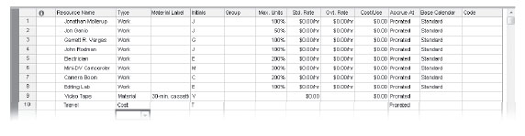
Setting Up Cost Resources
In the Resource Sheet, click the next empty cell in the Resource Name column
Type Travel and press Tab
In the Type field, click the down arrow, select Cost, and press Enter

Slide 21
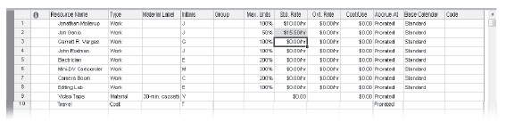
Entering Resource Pay Rates
For the TV commercial project you have been entrusted with pay rate information for all people resources used in the project
Must also pay rental fees for the camcorders and editing lab (the Southridge Video Company already owns the camera booms)

Slide 22
Entering Resource Pay Rates
In the Resource Sheet, click the Std. Rate field for Jonathan Mollerup
Type 10 and press Enter
  Jonathan’s standard hourly rate of $10 to appears in the Std. Rate column
  Note that the default standard rate is hourly, so you did not need to specify cost per hour
In the Std. Rate field for Jon Ganio, type 15.50 and press Enter
  Jon’s standard hourly rate appears in the Std. Rate column

Slide 23
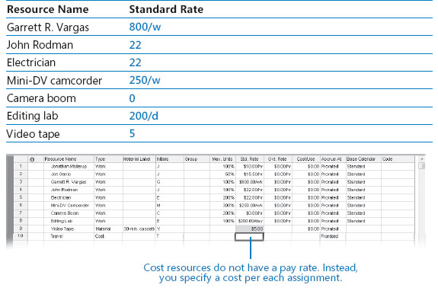
Entering Resource Pay Rates
Enter the following standard pay rates for the given resources

Slide 24
Entering Resource Pay Rates
Note that you enter a fixed amount rather than a rate (hourly, daily, or weekly) for the video tape’s cost
For material resources, the standard rate value is per unit of consumption—in our case, 30-minute cassettes
Note also that you cannot enter a standard pay rate for the Travel cost resource
You specify the cost when you assign the cost resource to a task

Slide 25
Adjusting Working Time for Individual Resources
A resource calendar controls the working and nonworking times of a resource
Project uses resource calendars to determine when work for specific resource can be scheduled
Resource calendars apply only to work resources (people and equipment) and not to material or cost resources
The initial working time settings for resource calendars exactly match those of the Standard base calendar
If all of the working times of your resources match the working time of the Standard base calendar, you do not need to edit any resource calendars
However, chances are that some of your resources will need exceptions to the working time in the Standard base calendar—such as
  A flex-time work schedule
  Vacation time

Slide 26
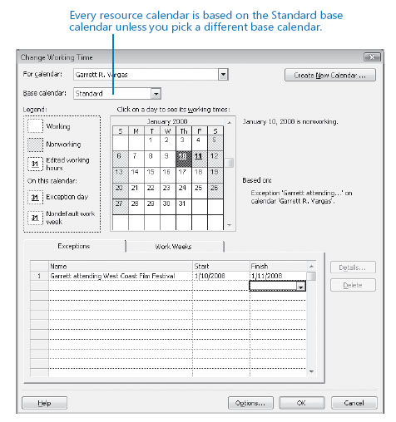
Adjusting Working Time for Individual Resources
On the Tools menu, click Change Working Time (The Change Working Time dialog box appears)
In the For calendar box, click Garrett H. Vargas (Garrett R. Vargas’s resource calendar appears in the Change Working Time dialog box)
Garrett has told you he will not be available to work on Thursday and Friday, January 10 and 11, because he plans to attend a film festival
On the Exceptions tab in the Change Working Time dialog box, click in the first row directly below the Name column heading and type Garrett attending West Coast Film Festival
Click in the Start field and type or select 1/10/2008
Click in the Finish field, type or select 1/11/2008 and then press Enter
Project will not schedule work fr Garrett on these dates

Slide 27
Adjusting Working Time for Individual Resources
Now you will set up a “4 by 10 work schedule (that is, 4 days per week, 10 hours per day) for a resource
In the For box, click John Rodman
When prompted to save the resource calendar changes that you made for Garrett click Yes
Click the Work Weeks tab in the Change Working Time dialog box

Slide 28
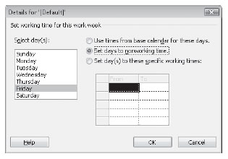
Adjusting Working Time for Individual Resources
Click [Default], and then click Details
Under Selected Day(s), select Monday through Thursday
Click Set day(s) to these specific working times
In the lower To box click 5:00 PM and replace it with 7:00 PM, and then press Enter
Click Friday and Click Set days to nonworking time
Now Project can schedule work for John as late as 7pm every Monday through Thursday, but it will not schedule work for him on Fridays

Slide 29
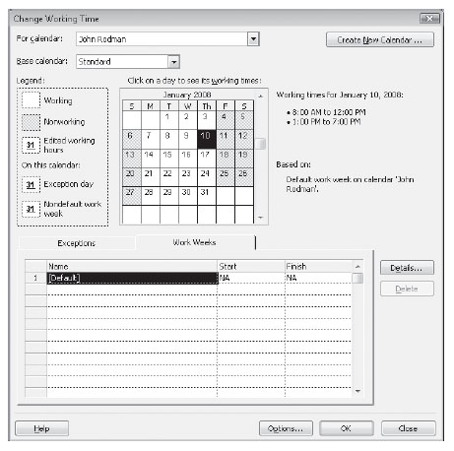
Adjusting Working Time for Individual Resources
Click OK to close the Details dialog box
Now you can see that Fridays are marked as nonworking days for John Rodman
Click OK to close the Change Working Time dialog box

Slide 30
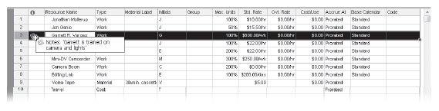
Documenting Resources
Now we will enter a note to remind us that a certain resource may play multiple roles in the TV commercial project
In the Resource Name column, click Garrett R. Vargas
On the Project menu, click Resource Notes (You can also click the Resource Notes button on the Standard toolbar)
  Project displays the Resource Information dialog box with the Notes tab visible
In the Notes box, type Garrett is trained on camera and lights and then click OK
  A note icon appears in the Indicators column
Point to the note icon

